Slide 1
How Computers Represent Data
DECI
Understanding Binary, Data Types, and Encoding

Slide 2
Table of contents
01
02
03
04
What Is Data?
The Language of Computers
Bits and Bytes
How Data Types Are Stored
Summary
Questions?
05
06

Slide 3
01
What Is Data?
Data is information — like your name, a photo, or a song.

Slide 4
What Is Data?
"Before we can understand how computers represent data, we need to answer a basic question: What is data?
In simple terms, data is information. It could be your name, a photo, a song, a temperature reading, or even a video.
To us, this information has meaning—but to a computer, everything must be turned into numbers. Whether it's text, images, or sound, a computer only understands it as a series of 0s and 1s, which is called binary.
So, no matter how complex or colorful the information appears to us, it always starts as numbers in the digital world."

Slide 5

The Language of Computers
02
Computers speak in Binary – only 0s and 1s!(Like a secret code!)

Slide 6

The Language of Computers
"Computers don't speak English, Arabic, or any human language. Instead, they use a language made up of just two symbols: 0 and 1. This is called the binary system.
Each 0 or 1 is called a bit, and it's the smallest unit of data in a computer. By combining bits into larger groups—like bytes (8 bits)—computers can represent all kinds of information: letters, numbers, images, sounds, and more.
This system may seem simple, but it’s powerful. Every app you use, video you watch, or message you send is built from these 0s and 1s. It’s how computers understand and execute everything."

Slide 7
03
Bits and Bytes
Bit: Smallest unit of data (0 or 1), Byte: Group of 8 bits

Slide 8
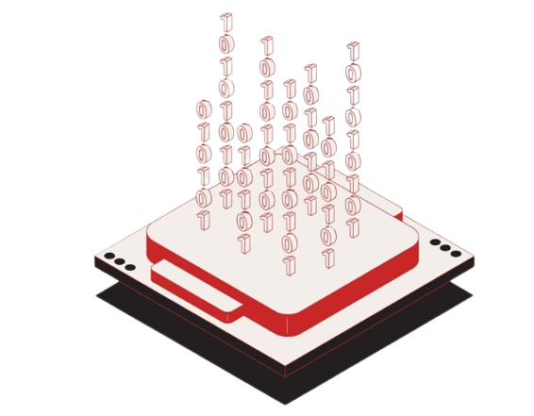
Bits and Bytes
"To understand how computers store data, we need to know about bits and bytes.
A bit (short for binary digit) is the smallest unit of data in a computer. It can only have one of two values: 0 or 1.
A byte is a group of 8 bits. One byte can represent 256 different combinations, which is enough to store one character, like the letter 'A' or a punctuation mark.
As data grows, we measure it in larger units:
1 kilobyte (KB) = about 1,000 bytes
1 megabyte (MB) = about 1 million bytes
1 gigabyte (GB) = about 1 billion bytes
1 terabyte (TB) = about 1 trillion bytes

Slide 9
How Data Types Are Stored
04

Slide 10
How Data Types Are Stored
"Computers handle many kinds of data, but they all have to be converted into binary (0s and 1s) to be stored or processed. Here's how different types of data are represented:
Numbers: Stored directly in binary. For example, the number 5 is stored as 0101. Computers use different formats for integers and decimal numbers (floating point).
Text: Stored using character encoding systems like ASCII or Unicode, where each letter or symbol is assigned a unique binary number. Example: 'A' = 01000001 in ASCII.
Pictures: Stored as a grid of pixels. Each pixel has a color value, usually represented by RGB (Red, Green, Blue) values in binary.
Sounds: Stored by sampling the sound wave at regular intervals (called the sample rate), and converting each sample into binary values.
Videos: Stored as a combination of images (frames) and sound, compressed and encoded using video formats (like MP4), and all of it ultimately becomes binary data too.

Slide 11
Summary
05
Computers turn everything into 0s and 1s

Slide 12

Summary
Every action we take on a digital device—sending a message, watching a video, or saving a file—involves converting real-world information into a format that computers understand: binary (0s and 1s). This session introduces the core concepts behind digital data representation, such as the binary system, data types, character encoding, and how multimedia is stored.
We begin by defining data as any form of meaningful information—text, images, sound—that must be translated into binary for a computer to process. Computers operate using the binary system, a language of 0s and 1s where each digit (bit) represents the smallest unit of data. These bits combine into bytes (8 bits), which are the building blocks for storing larger data like characters and images.

Slide 13

Any Questions?!

Slide 14
Books & Text Resources
CS50 Notes – Harvard University
Computer Science Field Guide – University of Canterbury
BBC Bitesize: Data Representation

Slide 15
Thanks!
Prepared by:
Youssef Walid Roby
joewaleedalroby@gmail.com

